Slide 1

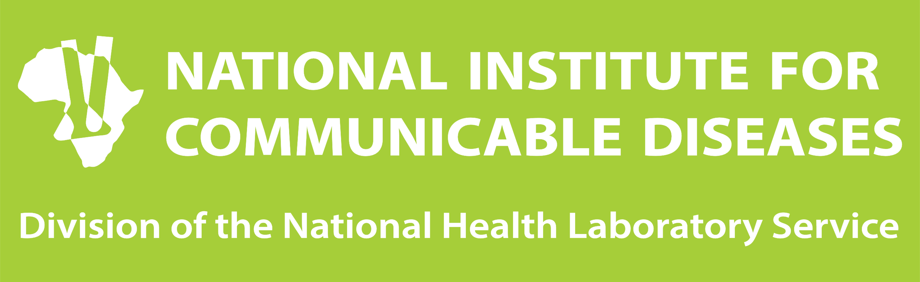
Zoonotic diseases and outbreaks
Detection, management and response
Dr Vuyiswa Kumalo
Outbreak Response Unit
Division of Public Health Surveillance and Response
9 September 2025

Slide 2
Overview
Understanding zoonotic diseases
Detection of zoonotic disease outbreaks
Principles of outbreak investigation
Actions taken in outbreak response

Slide 3
Definition
WHO: Infectious diseases naturally transmissible between vertebrate animals and humans through direct contact, vectors, food, water, or environmental exposure.
Transmission
Commonly spread at the animal-human interface, where people and animals interact with each other through a shared environment.
Can be transmitted via direct contact with animals, or be foodborne, waterborne, vector-borne, and even indirectly by environmental contamination.
Zoonotic diseases
Notes:
Def: 60% of existing human infectious diseases are zoonotic and that at least 75% of emerging infectious diseases are zoonotic. These numbers suggest that controlling the emergence of disease at the animal source should be more effective than trying to mitigate the consequences of spillover events (when an animal disease is first transmitted to humans) and the spread of disease among the human population.
In South Africa, the main interfaces are commercial poultry and piggeries, game farms and reserves, wildlife rehabilitation, and abattoirs.

Slide 4

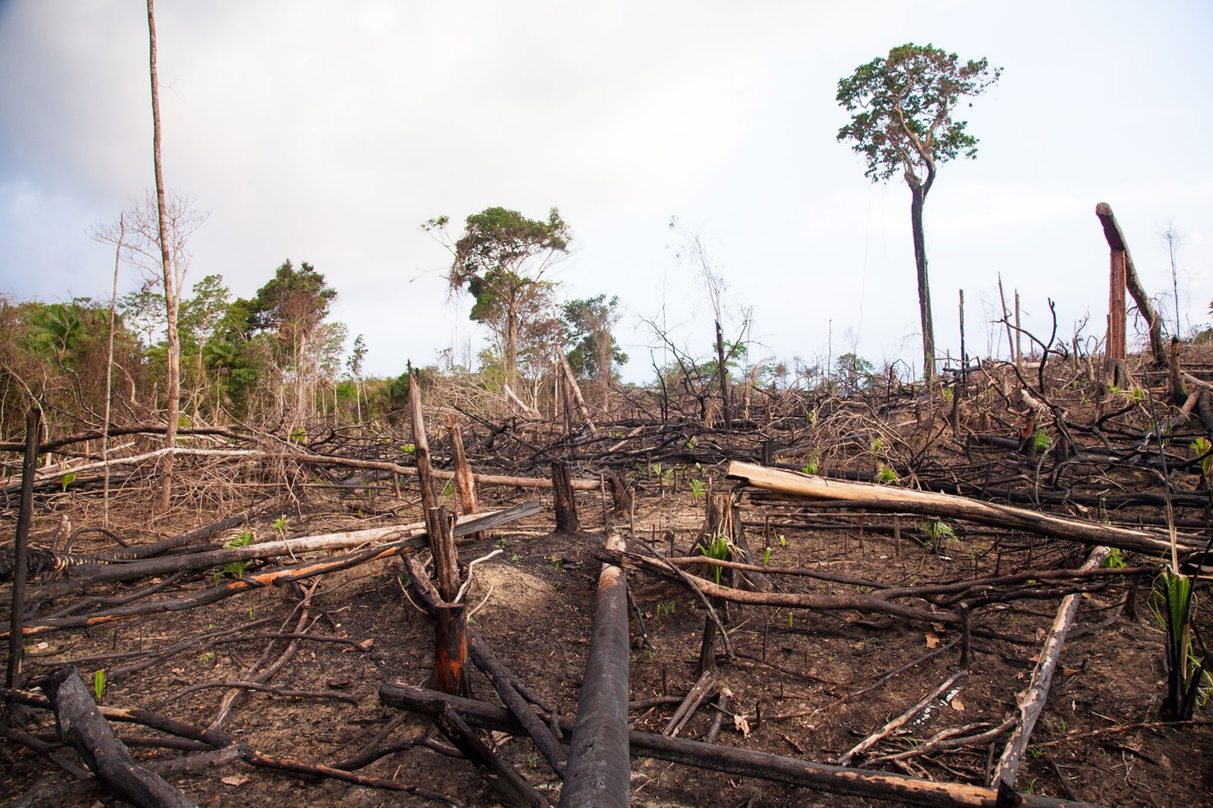
Drivers
Global movement and trade
Agricultural and food systems
Environmental and climate factors
Human-wildlife interface and antimicrobial resistance
Source: Yuru Herasimenka | Dreamstime.com
Source: National Geographic
Notes:
1. The way we live and travel today is a major factor in how diseases spread. The constant movement of people, animals, and goods means that a pathogen can be spread from one continent to another in hours. A big part of this is the global wildlife trade, where wild animals and their parts are bought and sold. This brings people into direct, close contact with all kinds of species from different ecosystems, creating the perfect conditions for a disease to jump from an animal to a human.
2. How we're changing the planet is also a huge part of the problem. When we chop down forests for things like farming and urban expansion, we're essentially pushing people and farm animals closer to wildlife. This increases the chances of a disease spreading.
3. Climate change also contributes. As temperatures rise, disease-carrying insects like mosquitoes and ticks can survive in new areas, bringing illnesses to places that have never seen them before.
4. Our food production systems, especially intensive animal farming, are creating ideal environments for diseases to emerge. Cramming a large number of animals into a small space makes it easy for an infection to spread quickly. The massive use of antibiotics in these farming practices is also a major concern. It's contributing to the rise of antimicrobial resistance (AMR), which means that bacteria are becoming stronger and medicines are becoming less effective at treating infections in both animals and humans.

Slide 5
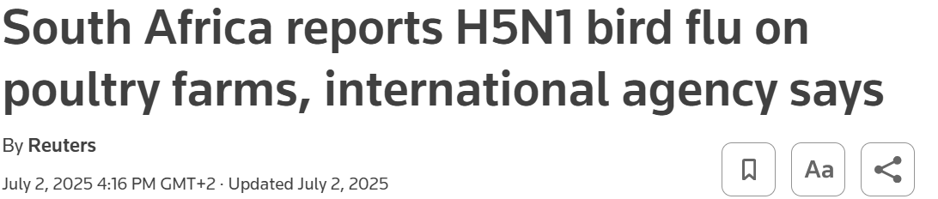
Animal-human interface in South Africa
Main: commercial poultry and piggeries, game farms and reserves, wildlife rehabilitation, and abattoirs
Sustainable-use wildlife economy and conservation model:
Managing wildlife to generate income while aiming to conserve species and habitats.
Leads to people and farm animals sharing spaces with wildlife
Rural communities and those with a close association with animals are generally at the highest risk of zoonotic infections.
Interfaces
Farm dams/ponds used by range poultry.
Uncovered open drinkers and spilled feed areas.
Free-range/backyard flocks foraging where wild birds congregate
Source: Reuters
Eg, Wild birds & poultry at shared water/feed sites
Avian Influenza outbreak in ostriches (2004 and beyond)
Outbreaks of ostrich illness are linked to contact between ostrich flocks and migratory water birds, which is facilitated by free-range farming practices.
Spill over:
Faecal-oral via water: Migratory and resident waterfowl shed virus into surface water. Ostriches drink or forage in contaminated dams, canals, or open troughs.
Free-range contact: The outdoor nature of ostrich farming increases indirect contact with wild birds that visit paddocks.
Humans
Does not typically infect or spread between humans but human infections have been documented.
Use PPE (gloves, mask/respirator, eye protection) for anyone handling birds.
Infection can occur if breathe in virus-containing droplets or dust, or touch contaminated bird or surface and then touch eyes, mouth, or nose.
Notes:
In South Africa, the main interfaces are commercial poultry and piggeries, game farms and reserves, wildlife rehabilitation, and abattoirs.
Sustainable use wild life economy and conservation model: Managing wildlife so they generate ongoing income (tourism, hunting, meat, live trade) while aiming to conserve species and habitats. Leads to people and farm animals sharing spaces with wildlife (grazing areas, water points, markets, handling carcasses)

Slide 6
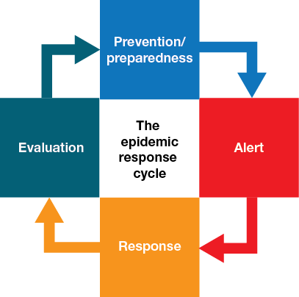
Outbreak management vs. response
Outbreak Management refers to the overarching, strategic, and continuous process of addressing an outbreak.
What is the strategy to handle the outbreak when it occurs?
Preparedness activities conducted
before an outbreak,
through the response to
the event itself, and into
the recovery and
evaluation.
Outbreak Response refers to the immediate, tactical, actions taken to control a disease outbreak once it has been detected.
What are the steps to contain the outbreak now as it occurs?
Field-level activities, including surveillance, case investigation, contact tracing, laboratory support, and the implementation of specific public health interventions.
Source: IFRC

Slide 7
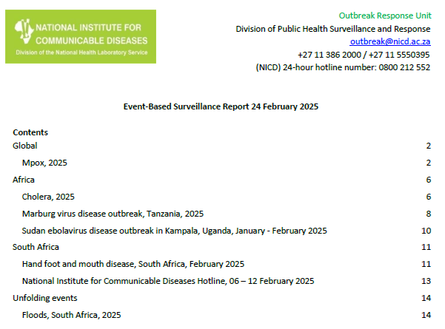
Outbreak Detection
One Health Approach
A multi-sectoral lens is vital for zoonotic threat detection.
The health of people is inextricably linked to the health of animals and the shared environment.
Detect potential public health threats by monitoring and analysing real-time information about health events.
Indicator-Based Surveillance
Facility Reports: Reports from hospitals and clinics on the number of patients with specific symptoms (e.g., severe respiratory illness).
Laboratory Positives: Immediate notification of positive lab tests for specific zoonotic pathogens of concern.
Source: NICD ORU
Event-Based Surveillance
Community & Veterinary Reports: Intelligence from hotlines, veterinarians, and animal health officials about unusual animal sickness or deaths.
Media Scanning & Social Listening: Monitoring news media and online sources for unofficial reports or rumours of disease events.
Notes:
Multiple methods of surveillance provide a comprehensive picture, allowing for rapid and robust detection of potential zoonotic threats.

Slide 8
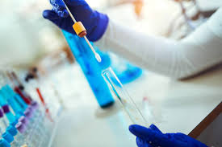
Principles of Investigation
Activation
A verified signal activates the investigation.
Communication is established with all key stakeholders from the start, using the One Health approach.
Immediate inclusion of veterinary, environmental and human health.
Epidemiological Investigation
Field teams deployed to establish connections between cases through case-finding and contact tracing.
The primary objective for a zoonotic disease is to identify the epidemiological link to an animal source.
Surveillance data (demographics, symptom onset, exposures) is important in this process.
Laboratory Support
Field investigation is supported by robust laboratory capabilities.
Samples are sent for analysis and molecular characterization.
Genomic sequencing provides precise information on the pathogen's type,
origin, and relationship to known strains, which refines disease understanding
and guides interventions.
Source: iStock
Notes:
Activation & Coordination: The first principle is activation. A signal like a lab positive, a cluster of cases, or a confirmed animal outbreak activates investigation. All key stakeholders are brought in from the start. This is a direct application of the One Health approach, as colleagues from veterinary services, environmental health, are included in addition to human health experts.
Epidemiological Investigation: The objective is to establish connections between cases through case-finding and contact tracing. For a zoonotic disease, the primary goal is to identify the epidemiological link to an animal source. Data provided by surveillance networks including demographics, symptom onset, and potential exposures is critical to this process.
3. Laboratory Support: Field investigation is supported by robust laboratory capabilities. Samples are immediately sent to the NICD's reference laboratory. The lab's function extends beyond diagnosis to include genomic sequencing, which provides precise information on the pathogen's type, origin, and relationship to other known strains. This information constitutes a feedback loop that refines understanding and guides interventions.

Slide 9
Response - First 72 hours
STAKEHOLDER | ROLE | ACTION (0-72 HOURS)
Outbreak Response Unit (ORU) | Technical support and reporting line for the multidisciplinary response. | Signal Awareness & Verification: Receives signals from surveillance streams (media scanning/hotline/email) and/or direct notification from provincial/district health teams. Verify signal. Notification: Alerts relevant provincial/district health teams (state vet incl.) about the potential threat. Technical Guidance: Provides ongoing technical support and can deploy to the field to assist local teams if needed.
Provincial/District Health Teams (CDC and Epidemiology) | Primary field investigators and implementers of public health responses. | Verification: Validates the initial signal and reports findings to the ORU. Case-Finding: Coordinates with healthcare facilities to identify and investigate additional cases on the ground. Line lists. Containment: Initiates immediate local-level public health measures and risk communication. Community Engagement: Works with stakeholders to inform and engage local communities on containment measures.
State Veterinary Services | Responsible for animal health surveillance and management of animal reservoirs. | Confirmation: Verifies the presence of a pathogen in animal populations. Epidemiological Investigation: Conducts a parallel investigation to identify the source of the outbreak in animals. Containment: Implements initial biosecurity and containment measures (e.g., quarantine, culling) at the animal source.
Environmental Health Practitioners (Provincial and municipal) | Assessment of environmental risk factors and implementers of environmental interventions. | Risk Assessment: Conducts environmental risk assessments at the source of outbreak (e.g., farms, water sources). Vector Control: Implements and monitors measures to control vectors (e.g., mosquitoes) to stop transmission. Food and Water Safety: Investigates potential contamination of food and water supplies. Waste Management: Ensures proper disposal of waste, including contaminated materials from animal or human sources, to reduce environmental spread.
NICD Laboratories | Provides diagnostic and scientific support. | Diagnosis: Performs diagnostic testing to confirm the pathogen. Molecular Characterization: Conducts genomic sequencing to understand the pathogen's origin and potential for transmission. Data Reporting: Feeds real-time data on lab results back to stakeholders.

Slide 10
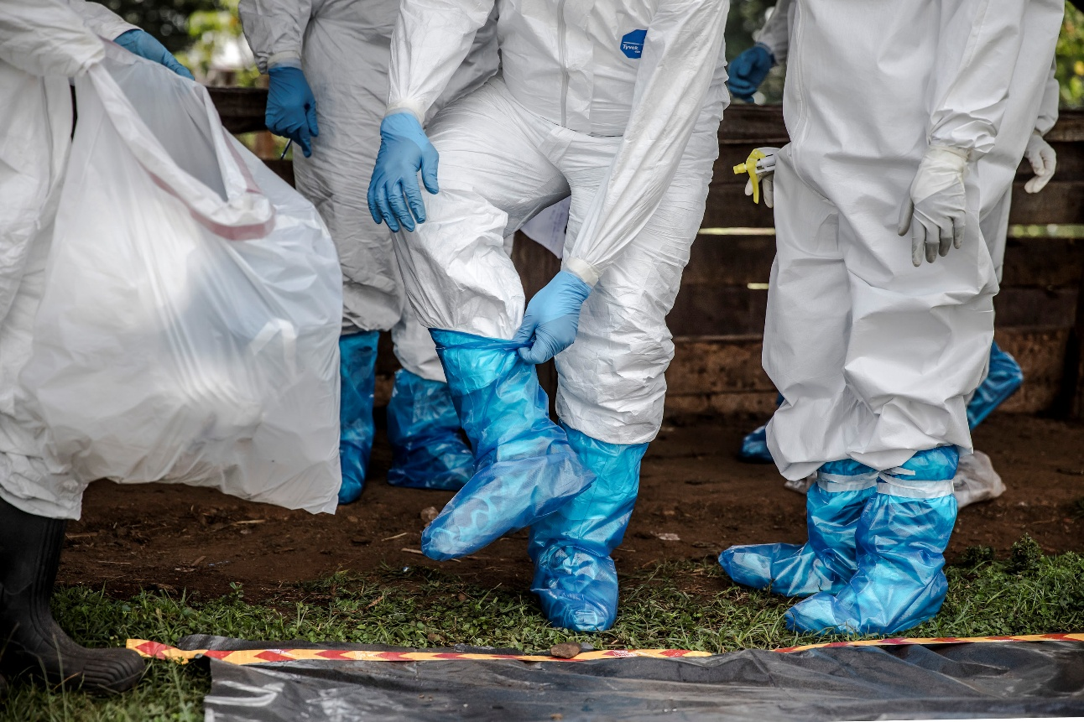
Response
Based on the investigation and lab findings, implement targeted
public health response to stop transmission.
Control measures include:
Case isolation and contact management (tracing and quarantine) to break human-to-human transmission.
Biosecurity and IPC measures (appropriate PPE, cohorting, environmental hygiene) across human and animal settings.
Prophylaxis or vaccination for defined risk groups where available.
Animal health actions with partners: quarantine/movement controls, ring vaccination, or humane culling/depopulation when warranted.
Targeted vector or reservoir control aligned to the pathogen’s ecology.
Clear risk communication to communities and high-risk occupations with guidance.
Ongoing surveillance and laboratory confirmation to track impact and adjust interventions
Source: FAO/Luis Tato

Slide 11
Respiratory zoonoses outbreaks in SA
2017 First major HPAI H5N8 outbreak affecting commercial poultry
Index detections were in commercial poultry (Mpumalanga) with rapid multi-province spread thereafter.
Control actions included culling of affected flocks, movement/trade restrictions, quarantine, and heightened biosecurity.
Animal-health authorities and ARC-Onderstepoort led animal diagnostics and control.
NICD/NHLS ran human exposure surveillance and reporting (no confirmed human cases).
Lesson: Rapid field specimens submission to lab and clear roles across animal and human health.
2020 COVID-19 largest modern respiratory outbreak of zoonotic origin
Detected 5 March 2020; rapid community spread followed. Now primarily human-human transmission.
Controls: a national lockdown with risk-adjusted alert levels, test/trace/isolate strategy, a vaccine rollout (Sisonke for healthcare workers, then the national programme), and real-time genomic (NGS-SA) plus hospital (DATCOV) surveillance.
Lesson: Robust surveillance with public messaging (hotline/WhatsApp updates) and sector-specific guidance so provinces and districts activate timely, proportionate measures in the highest-risk settings.

Slide 12
Outbreak detection, management and response
PLAN: Standardised preparedness and response plan and/approach to ensure efficient and rapid response.
MULTISECTORAL COLLABORATION: One health approach for zoonotic diseases. Integrate animal, human and environmental health efforts.
INTEGRATED SURVEILLANCE: Early detection through indicator-based and event-based surveillance for rapid response.
CLEAR COMMUNICATION: Timely and accurate communication between internal and external stakeholders.
LABORATORY ROLE: Diagnosis and genomic sequencing for comprehensive information of pathogen(s).
ADAPTABLE: Outbreaks can evolve, flexibility allows for managing challenges or new information

Slide 13
References
Gebreyes WA, Dupouy-Camet J, Newport MJ, Oliveira CJB, Schlesinger LS, Saif YM, et al. The global One Health paradigm: challenges and opportunities for tackling infectious diseases at the human, animal, and environment interface in low-resource settings. PLoS Negl Trop Dis. 2014 Nov 13;8(11):e3257. 10.1371/journal.pntd.0003257.
Taylor LH, Latham SM, Woolhouse ME. Risk factors for human disease emergence. Philos Trans R Soc Lond B. 2001 Jul 29;356(1411):983-9. 10.1098/rstb.2001.0888.
Berrian AM, Martínez-López B, Quan V, Conrad PA, van Rooyen J, Simpson GJG, et al. Risk factors for bacterial zoonotic pathogens in acutely febrile patients in Mpumalanga Province, South Africa. Zoonoses Public Health. 2019 Aug;66(5):458-469. 10.1111/zph.12577.
Venter M, Treurnicht FK, Buys A, Tempia S, Samudzi R, McAnerney J, et al. Risk of human infections with highly pathogenic H5N2 and low pathogenic H7N1 avian influenza strains during outbreaks in ostriches in South Africa. J Infect Dis. 2017 Sep 15;216(Suppl 4):S512-S519. 10.1093/infdis/jix018.
Abolnik C, Olivier A, Reynolds C, Henry D, Cumming G, Rauff D, et al. Susceptibility and status of avian influenza in ostriches. Avian Dis. 2016 May;60(1 Suppl):286-95. 10.1637/11110-042815-Reg.
Blumberg L, de Jong G, Thomas J, Archer BN, Cengimbo A, Cohen C. Outbreaks in South Africa 2004–2011, the Outbreak Response Unit of the NICD, and the vision of an inspired leader. S Afr J Epidemiol Infect. 2011;26(4):195-197. 10.1080/10158782.2011.11441450.
Food and Agriculture Organization of the United Nations, World Organisation for Animal Health, World Health Organization. Taking a multisectoral, One Health approach: a tripartite guide to addressing zoonotic diseases in countries [Internet]. Geneva: WHO; 2019 [cited 2025 Sep 7]. Available from: https://www.who.int/publications/i/item/9789241514934.
National Institute for Communicable Diseases. Communicable Diseases Communiqué: Zoonotic and vector-borne diseases update [Internet]. Johannesburg: NICD; 2022 [cited 2025 Sep 7]. Available from: https://www.nicd.ac.za/wp-content/uploads/2022/10/ZOONOTIC-AND-VECTOR-BORNE-DISEASES.pdf.
World Health Organization. Response preparedness for zoonotic disease outbreaks using a One-Health approach (OpenWHO course) [Internet]. Geneva: WHO; [cited 2025 Sep 7]. Available from: https://openwho.org/courses/reprep-zoonotic-outbreaks.

Slide 14

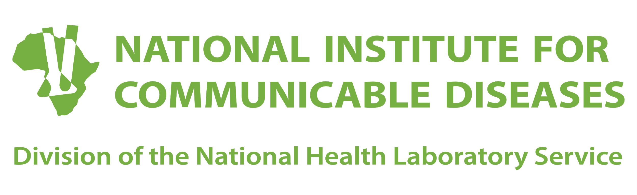
NICD Hotline (for health professionals):
0800 212 552
Email:
outbreak@nicd.ac.za
Thank You
Notes:
Thank you for your time.

